Slide 1
Java Programming
Files & I/O

Slide 2
Outline
Files
Streams
Character set*
File I/O
FileReader & FileWriter
Standard I/O
Network I/O *

Slide 3
Files
For permanent storage, computers use files.
Files are organized into directories (sometimes called folders).
A directory can hold other directories, as well as files. Both directories and files have names that are used to identify them.
The class java.io.File can represent either a file or a directory.

Slide 4
Path string
A path string is used to locate a file or a directory. Unfortunately, path strings are system dependent, e.g.,
"c:\myproject\java\Hello.java" in Windows
or "/myproject/java/Hello.java" in Unix/Mac.
Path strings | Unix/Mac | Windows
directory separator | forward-slash '/' | back-slash '\'
path separator | use colon ':' | use semi-colon ';'
line delimiter | use "\n" | uses “\r\n".
root | uses single root ("\") | uses multiple roots, each maps to a drive (e.g., "c:\", "d:\")

Slide 5
Creating a File
You can construct a File instance with a path string or URI, as follows.
Constructs a File instance based on the given path string.
public File(String pathString)
public File(String parent, String child)
public File(File parent, String child)
Constructs a File instance by converting from the given file-URI. e.g., file:///d:/codes/java/test.html
public File(URI uri)

Slide 6
Frequently used methods
public boolean exists() // Tests if this file/directory exists.
public long length() // Returns the length of this file.
public boolean isDirectory() // Tests if this instance is a directory.
public boolean isFile() // Tests if this instance is a file.
public boolean canRead() // Tests if this file is readable.
public boolean canWrite() // Tests if this file is writable.
public boolean delete() // Deletes this file/directory.
public void deleteOnExit() // Deletes this file/directory
public boolean renameTo(File dest) // Renames this file.
public boolean mkdir() // Makes (Creates) this directory.

Slide 7
List Directory
List Directory
public String[] list() // List the contents of this directory in a String-array
public File[] listFiles() // List the contents of this directory in a File-array
List Directory with Filter
public String[] list(FilenameFilter filter)
public File[] listFiles(FilenameFilter filter)
public File[] listFiles(FileFilter filter)

Slide 8
Example: List Directory
import java.io.File;
public class ListDirectoryRecusive {
public static void main(String[] args) {
File dir = new File("d:\\myproject\\test"); // Escape sequence needed for '\'
listRecursive(dir);
}
public static void listRecursive(File dir) {
if (dir.isDirectory()) {
File[] items = dir.listFiles();
for (File item : items) {
System.out.println(item.getAbsoluteFile());
if (item.isDirectory()) listRecursive(item); // Recursive call
}
}
}
}

Slide 9
Example: List Directory with Filter
// List files that end with ".java"
import java.io.File;
import java.io.FilenameFilter;
public class ListDirectoryWithFilter {
public static void main(String[] args) {
File dir = new File("."); // current working directory
if (dir.isDirectory()) {
// List only files that meet the filtering criteria which programmed in accept() method of FilenameFilter.
String[] files = dir.list(new FilenameFilter() {
public boolean accept(File dir, String file) {
return file.endsWith(".java");
}
}); // an anonymous inner class as FilenameFilter
for (String file : files) {
System.out.println(file);
}
}
}
}

Slide 10
Streams

Slide 11
Streams
Programs read inputs from data sources (e.g., keyboard, file, network, memory buffer, or another program) and write outputs to data sinks (e.g., display console, file, network, memory buffer, or another program).
If a programming language had to deal with each type of device as a special case, the complexity would be overwhelming.

Slide 12
Streams
The good facilities for doing input and output is to provide universal abstractions for representing I/O devices.
In Java, In Java, the main I/O abstractions are called streams.
A stream is a sequential and contiguous one-way flow of data (just like water or oil flows through the pipe).

Slide 13
Streams
Stream I/O operations involve three steps:
Open an input/output stream associated with a physical device (e.g., file, network, console/keyboard), by constructing an appropriate I/O stream instance.
Read from the opened input stream until "end-of-stream" encountered, or write to the opened output stream (and optionally flush the buffered output).
Close the input/output stream.

Slide 14
Streams
The beauty of the stream abstraction is that it is as easy to write data to a file or to send data over a network as it is to print information on the screen.
The standard stream classes discussed are defined in the package java.io, along with several supporting classes.

Slide 15
Streams
There are two broad categories of data: machine-formatted data and human-readable text.
As a consequence, Java needs to differentiate between byte-based I/O for processing raw bytes or binary data, and character-based I/O for processing texts made up of characters.

Slide 16
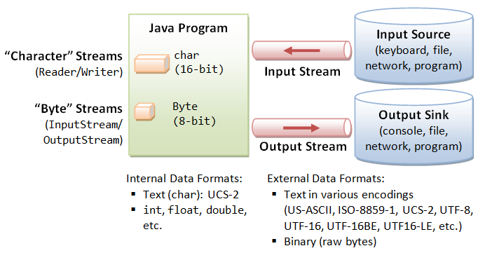
Streams
Notes:
http://www3.ntu.edu.sg/home/ehchua/programming/java/J5b_IO.html

Slide 17
Character set
There are various ways for characters to be encoded as binary data.
A particular encoding is known as a charset or character set. Charsets have standardized names such as “UTF-16,”“UTF-8,” and “ISO-8859-1.”
In UTF-16, characters are encoded as 16-bit UNICODE values; this is the character set that is used internally by Java.
UTF-8 is a way of encoding UNICODE characters using 8 bits for common ASCII characters and longer codes for other characters.
ISO-8859-1, also known as “Latin-1,” is an 8-bit encoding that includes ASCII characters as well as certain accented characters that are used in several European languages.

Slide 18
Character set
Java internally stores characters (char type) in 16-bit UCS-2 character set.
But the external data source/sink could store characters in other character set (e.g., US-ASCII, ISO-8859-x, UTF-8, UTF-16, and many others), in fixed length of 8-bit or 16-bit, or in variable length of 1 to 4 bytes.

Slide 19
Character set conversion
Since JDK 1.4, Java provides a new package java.nio.charset as part of NIO (New IO) to support character translation between the Unicode (UCS-2) used internally in Java program and external devices which could be encoded in any other format (e.g., US-ASCII, ISO-8859-x, UTF-8, UTF-16, UTF-16BE, UTF-16LE, and etc.)
The main class java.nio.charset.Charset provides static methods for testing whether a particular charset is supported, locating charset instances by name, and listing all the available charsets and the default charset.

Slide 20
java.nio.charset.Charset
lists all the available charsets
public static SortedMap<String,Charset> availableCharsets()
Returns the default charset
public static Charset defaultCharset()
Returns a Charset instance for the given charset name (in String)
public static Charset forName(String charsetName)
Tests if this charset name is supported
public static boolean isSupported(String charsetName)

Slide 21
java.nio.charset.Charset
Encodes Unicode UCS-2 characters in the CharBuffer/String into a "byte sequence" using this charset, and returns a ByteBuffer.
public final ByteBuffer encode(String s)
public final ByteBuffer encode(CharBuffer cb)
Decode the byte sequence encoded using this charset in the ByteBuffer to Unicode UCS-2, and return a charBuffer.
public final CharBuffer decode(ByteBuffer bb)

Slide 22
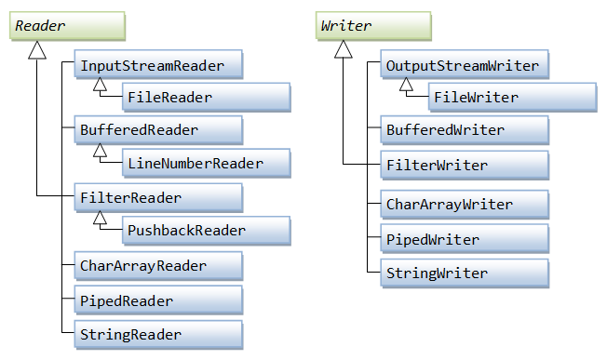
Character-Based I/O

Slide 23
FileReader & FileWriter
Human-readable character data can be read from a file using an object belonging to the class FileReader, which is a subclass of Reader.
Similarly, data can be written to a file in human-readable format through an object of type FileWriter, a subclass of Writer.
For files that store data in machine format, the appropriate I/O classes are FileInputStream and FileOutputStream.

Slide 24
BufferedReader
Reads text from a character-input stream, buffering characters so as to provide for the efficient reading of characters, arrays, and lines.
BufferedReader in
= new BufferedReader(new FileReader("foo.in"));

Slide 25
Code structure using FileReader
FileReader reader;
try {
reader = new FileReader("data.txt");
… //read data and process them
}
catch (FileNotFoundException e) {
... // do something to handle the error
}

Slide 26
Code structure using FileWriter
FileWriter writer;
try {
writer = new FileWriter(fileName, false);
… // write data
} catch (IOException e) {
… // do something to handle the error
}

Slide 27
InputStreamReader & OutputStreamWriter
The FileReader/FileWriter introduced earlier uses the default charset for decoding/encoding, resulted in non-portable programs.
To choose the charset, you need to use InputStreamReader and OutputStreamWriter. They are considered to be byte-to-character "bridge" streams.

Slide 28
Write the BMI data into a text file
public static void saveFile(ArrayList<Student> students,String fileName) {
try {
FileWriter writer = new FileWriter(fileName, false);
for(Student st: students){
writer.write(String.format("%s,%s,%.2f,%.2f\r\n",
st.id,st.name,st.height,st.weight));
}
writer.close();
} catch (IOException e) {
e.printStackTrace();
}
}

Slide 29
Read BMI data from a text file
public static ArrayList<Student> readFile(String fileName) {
File file = new File(fileName);
BufferedReader reader = null;
ArrayList<Student> v= new ArrayList<Student>();
try {
reader = new BufferedReader(new FileReader(file));
String tempString = null;
while ((tempString = reader.readLine()) != null) {
String[] a= tempString.split(",");
Student st= new Student(a[0],a[1],Double.parseDouble(a[2]),Double.parseDouble(a[3]));
v.add(st);
}
reader.close();
return v;
} catch (IOException e) {
e.printStackTrace();
}
return v;
}

Slide 30
Counting lines of code
Lines of code (LOC), is a software metric used to measure the size of a computer program by counting the number of lines in the text of the program's source code.
LOC is typically used to predict the amount of effort to develop a program, or to estimate the maintainability of a program.

Slide 31
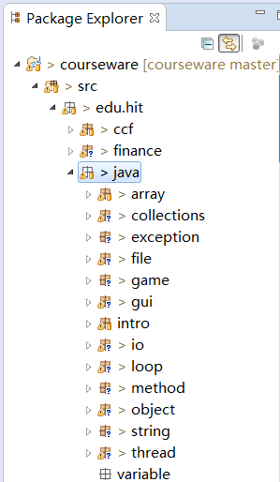
Counting lines of code
We classify lines of code into three types:
White lines
Comment lines
Normal lines
We are going to count the three types of the LOCs respectively for all the java source files in the workspace of Eclipse.

Slide 32
public class LineCounter {
private int whiteLines=0;
private int commentLines=0;
private int normalLines=0;
private int totalLines=0;
private int totalFiles=0;
public void treeFiles(File path) {…}
private void countFile(File file) {…}
private void countLines(BufferedReader br) {…}
public static void main(String args[]) {…}
}

Slide 33
public void treeFiles(File path) {
File[] childs = path.listFiles();
for (int i = 0; i < childs.length; i++) {
if (!childs[i].isDirectory()) {
if (childs[i].getName().endsWith(".java")) {
System.out.println("counting..." + childs[i].getName() );
countFile(childs[i]);
totalFiles++;
}
} else {
treeFile(childs[i]);
}
}
}

Slide 34
private void countFile(File file) {
BufferedReader br = null;
try {
br = new BufferedReader(new FileReader(file));
countLines(br);
} catch (FileNotFoundException e) {
e.printStackTrace();
} finally {
if (br != null) {
try {
br.close();
br = null;
} catch (IOException e) {
e.printStackTrace();
}
}
}

Slide 35
private void countLines(BufferedReader br) {
String line = "";
boolean comment = false;
try {
while ((line = br.readLine()) != null) {
line = line.trim(); totalLines++;
if (line.length()==0) {
whiteLines++;
} else if (line.startsWith("/*") && line.endsWith("*/")) {
commentLines++;
} else if (line.startsWith("/*") && !line.endsWith("*/")) {
commentLines++;
comment = true;
} else if (true == comment) {
commentLines++;
if (line.endsWith("*/")) comment = false;
} else if (line.startsWith("//")) {
commentLines++;
} else {
normalLines++;
}
}
} catch (IOException e) {
e.printStackTrace();
}
}

Slide 36
public static void main(String args[]) {
File path = new File(args[0]);
long start=System.currentTimeMillis();
System.out.println("counting dictionary:"+args[0]);
LineCounter lc= new LineCounter();
lc.treeFiles(path);
System.out.println("counting is finishing!");
System.out.println("commentLines:"+lc.commentLines);
System.out.println("normalLines:"+lc.normalLines);
System.out.println("whiteLines:"+lc.whiteLines);
System.out.println("totalLines:"+lc.totalLines);
long end=System.currentTimeMillis();
System.out.println("your program spent "+(end-start)+"ms");
}

Slide 37
Byte-based I/O
Byte streams can be useful for direct machine-to-machine communication, and they can sometimes be useful for storing data in files, especially when large amounts of data need to be stored efficiently.
However, binary data is fragile in the sense that its meaning is not self-evident.

Slide 38
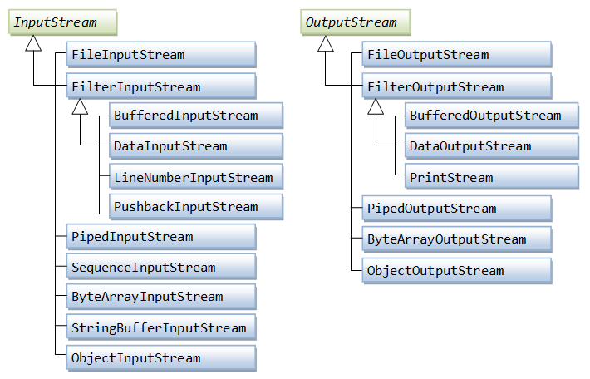
Byte-based I/O

Slide 39
Character-Based I/O
The character data are also coded as binary numbers.
But the character data has been standardized and is well understood, and data expressed in character form can be made meaningful to human readers.
The current trend seems to be towards increased use of character data, represented in a way that will make its meaning as self-evident as possible.

Slide 40
Other I/O APIs
Standard I/O
Network I/O
Web I/O
Socket I/O

Slide 41
Standard I/O
What is standard I/O?
The standard input and standard output stream notion is based on the concept of working on a system that has a standard input device and a standard output device.
On DOS and UNIX systems, the default standard input device is the keyboard, but it can be redirected to a different device at the operating system level.
Likewise, the default standard output device is the screen (also called console), but it can be redirected at the operating system level to another device.

Slide 42
Java Standard I/O
The 3 streams System.in, System.out, and System.err are common sources or destinations of data.
Most commonly used is probably System.out for writing output to the console from console programs.
These 3 streams are initialized by the Java runtime when a JVM starts up, so you don't have to instantiate any streams yourself.

Slide 43
Standard I/O
System.in
System.in is an InputStream which is typically connected to keyboard input of console programs.
System.out
System.out is a PrintStream. System.out normally outputs the data you write to it to the console.
System.err
System.err is a PrintStream. System.err works like System.out except it is normally only used to output error texts.
Some programs (like Eclipse) will show the output to System.err in red text, to make it more obvious that it is error text.

Slide 44
Standard I/O
Java has been notable for its lack of built-in support for basic input.
The Scanner class was introduced to make it easier to read basic data types from a character input source.
The scanner acts as a wrapper for the input source. The source can be a Reader, an InputStream, a String, or a File.

Slide 45
Redirect Standard I/O
Even though the 3 System streams are static members of the java.lang.System class, and are pre-instantiated at JVM startup, you can change what streams to use for each of them.
To set a new System stream, use one of the methods System.setIn(), System.setOut() or System.setErr().

Slide 46
Redirect Standard I/O
Here is a simple example:
OutputStream output = new FileOutputStream("c:\\data\\system.out.txt");
PrintStream printOut = new PrintStream(output);
System.setOut(printOut);

Slide 47
Network I/O
As far as a program is concerned, a network is just another possible source of input data, and another place where data can be output.
In Java, you can do network communication using input streams and output streams, just as you can use such streams to communicate with the user or to work with files.

Slide 48
Network I/O
One of the standard Java packages is called java.net. This package includes several classes that can be used for networking.
Two different styles of network I/O are supported.
high-level I/O (Web I/O),
is based on the World-Wide Web, and provides the sort of network communication capability that is used by a Web browser when it downloads pages for you to view.
low level I/O (Soket I/O),
it is more general and more important. It is based on a pair of protocols called the Transmission Control Protocol and the Internet Protocol, which are collectively referred to as TCP/IP.

Slide 49
Web I/O
The main classes for this style of networking are java.net.URL and java.net.URLConnection.
An object belonging to the URL class represents such an address.
A URLConnection represents a network connection to such a resource.

Slide 50
Web I/O
URL url = new URL(urlString);
URLConnection connection = url.openConnection();
InputStream urlData = connection.getInputStream();
BufferedReader in; // For reading from the connection’s input stream.
in = new BufferedReader( new InputStreamReader(urlData) );
while (true) {
String line = in.readLine();
if (line == null)
break;
System.out.println(line);
}
in.close();

Slide 51
Socket I/O
For two programs to communicate using TCP/IP, each program must create a socket.
A socket is one endpoint of a two-way communication link between two programs running on the network. An endpoint is a combination of an IP address and a port number.
In particular, a program can have several sockets at the same time, each connecting it to another program running on some other computer on the network—or even running on the same computer.

Slide 52

client/server model
Socket I/O involves two programs, one program must create a socket that will wait passively until a connection request comes in from another socket. The waiting socket is said to be listening for a connection.
A program that creates a listening socket is sometimes said to be a server, and a program that connects to a server is called a client.
The server can be thought of as offering some kind of service, and the client gets access to that service by connecting to the server. This is called the client/server model of network communication.

Slide 53
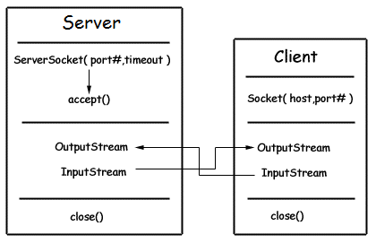
Socket I/O API
To implement TCP/IP connections, the java.net package provides two classes, ServerSocket and Socket.
A socket is bound to a port number so that the TCP layer can identify the application that data is destined to be sent to.
Once such a connection is made, communication takes place using input streams and output streams. Each program has its own input stream and its own output stream.

Slide 54
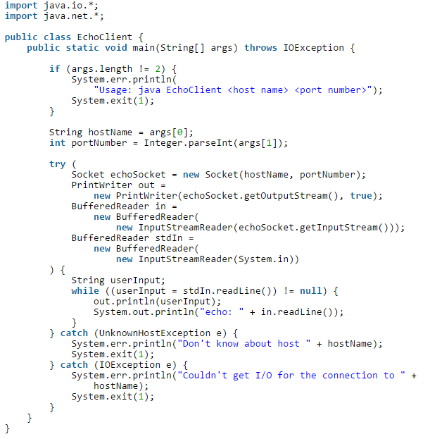
Echo client

Slide 55
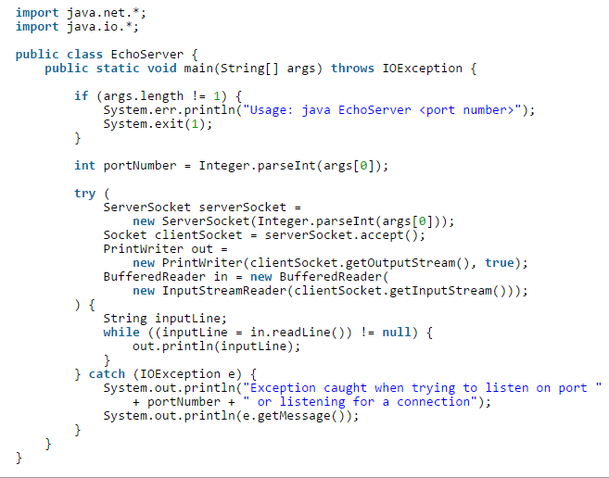
Echo server
http://docs.oracle.com/javase/tutorial/networking/sockets/readingWriting.html

Slide 56


